Slide 1
Yilime: The interactive Pet

Slide 2


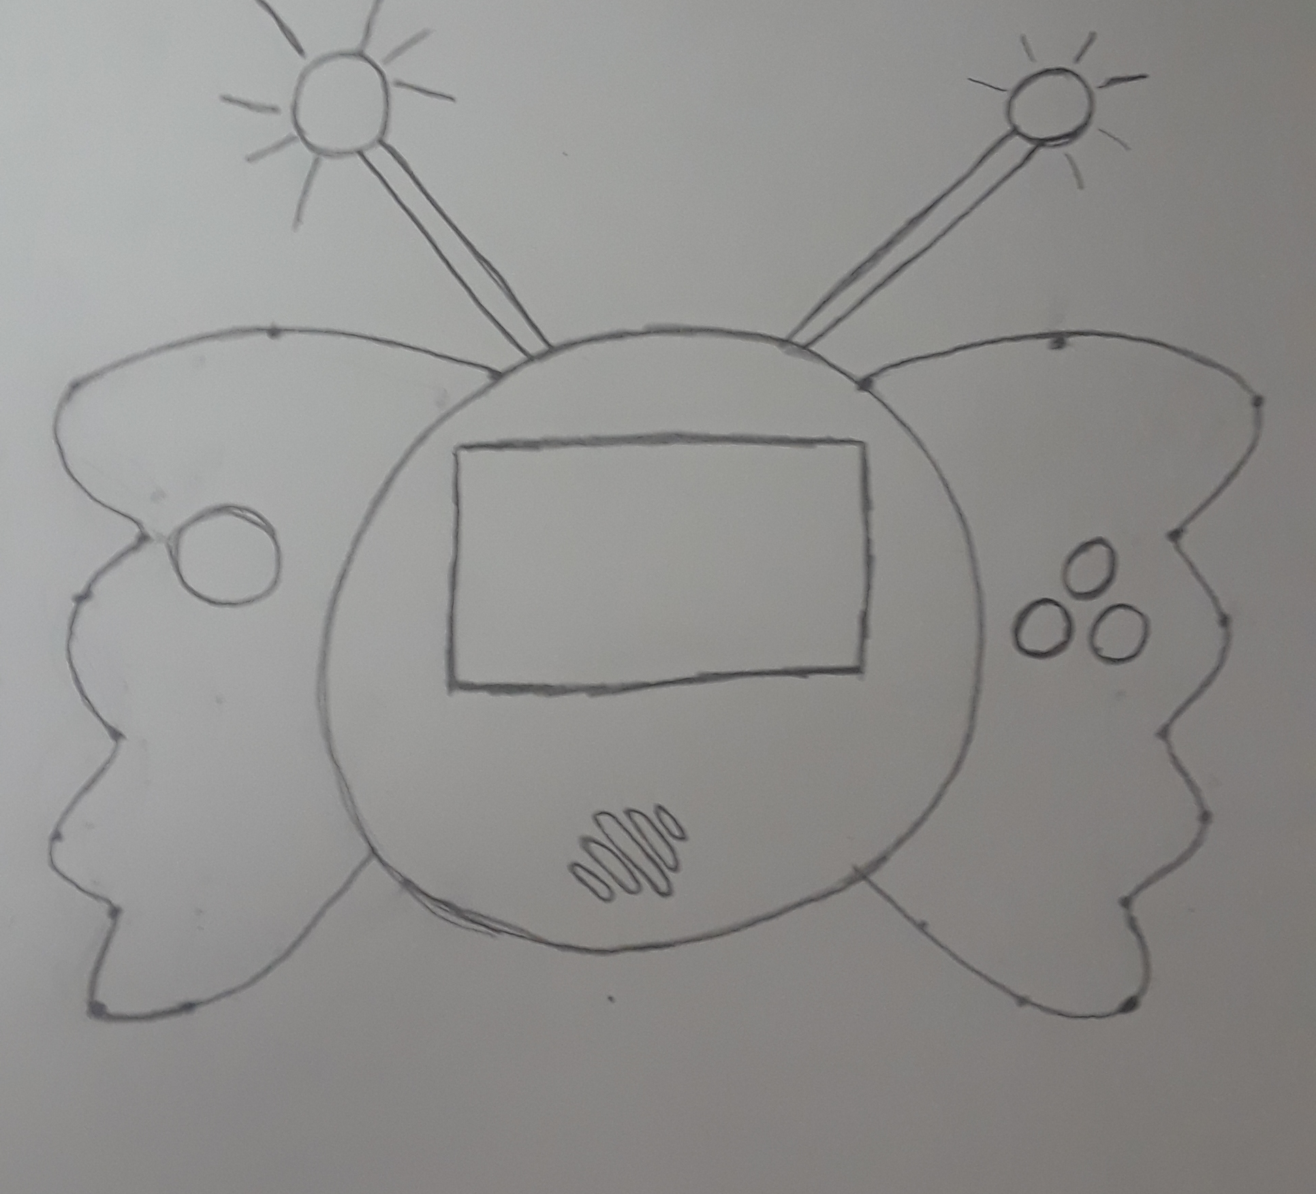
The Enclosure
3D Printed
Hardware:
Joystick
2-4 pushbuttons
LCD Color Display
Neopixel
Slide Switch
Piezo Buzzer
Sensors
Triple-Axis Gyro Breakout Board
Temperature or Microphone (?)

Slide 3
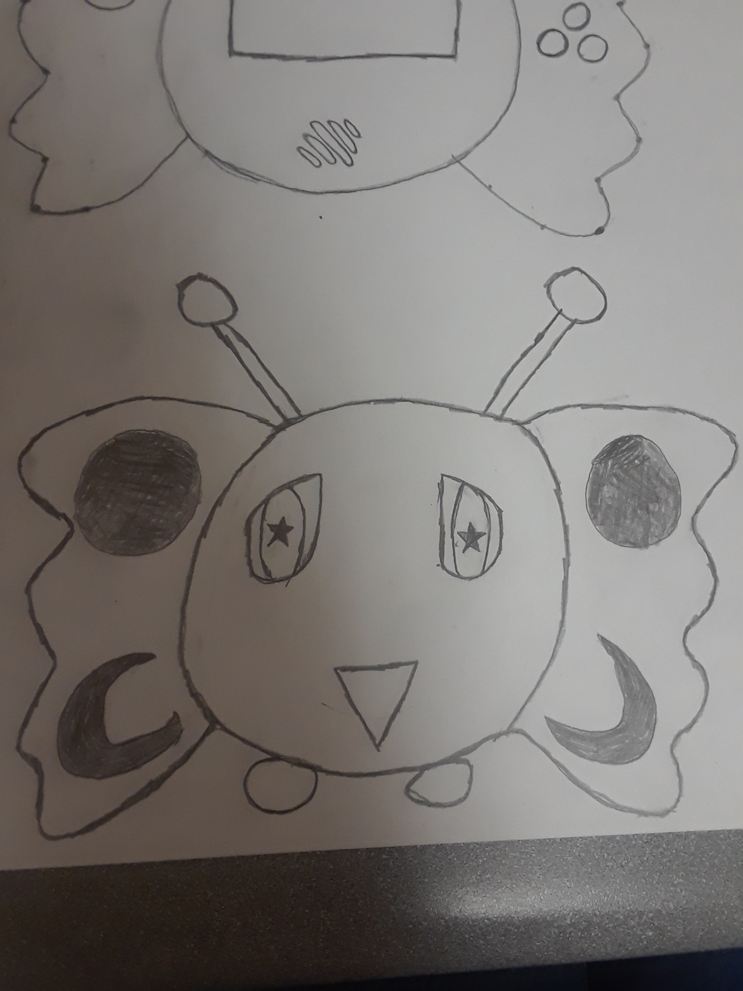
Yilime
Yilime is a baby dark fey
She needs to be fed, cleaned, and played with.
Besides managing her health, she has a Happiness Meter
Likes: Fairy Floss, Fairy Ringlets, Warm weather (?)
Dislikes: Being dropped, being called a pixie (?), Cold weather (?), Iron (* Not only because it is ironic) and Fire (*)

Slide 4
Triple-Axis Gyro Breakout Board
A gyroscope is a type of sensor that can sense twisting and turning motions. Often paired with an accelerometer, you can use these to do 3D motion capture and inertial measurement (that is - you can tell how an object is moving!)
$12.50

Slide 5
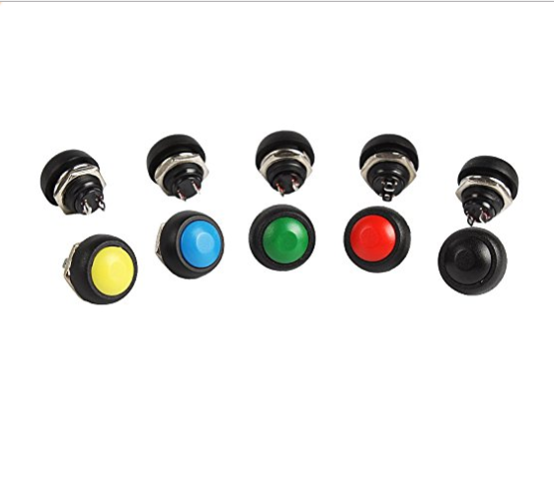
User Interface
2-Axis Joystick
Distinctive Buttons

Slide 6
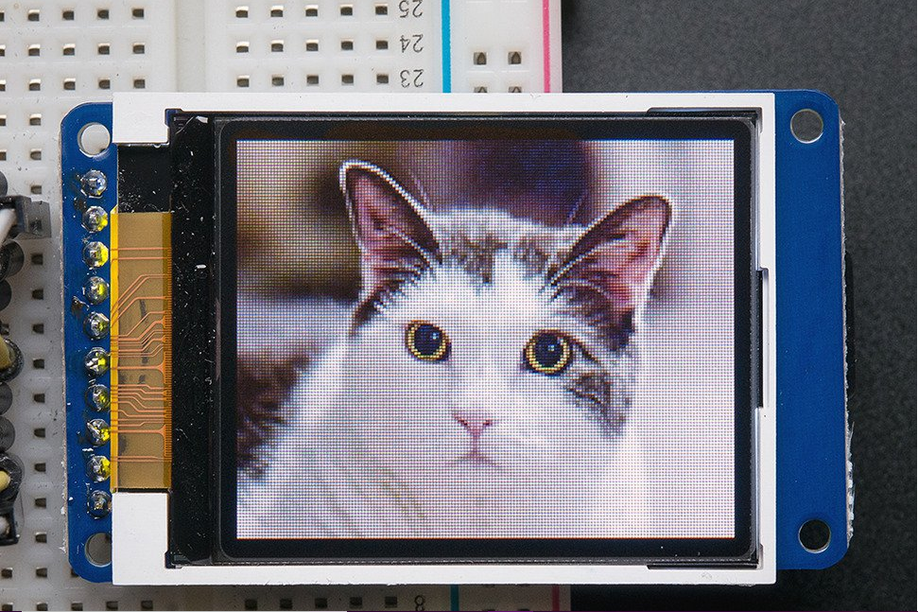
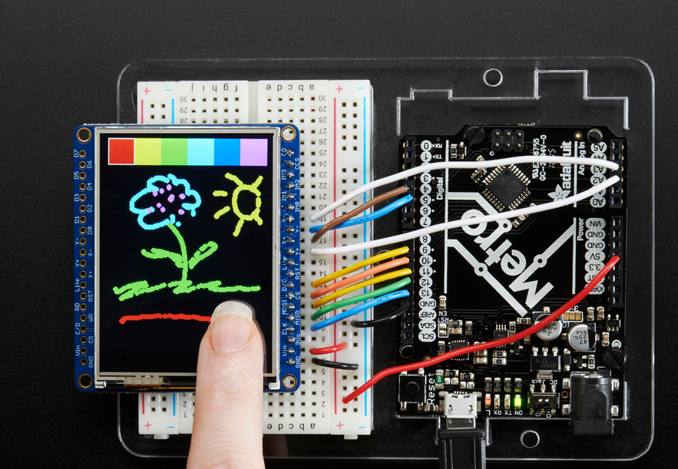
Display dilemma
Without Touchscreen (1.8)
With a Touchscreen (2.4)

Slide 7
Focus
To make the device interactive and for the virtual pet to have a distinct personality.
The user interacts with Yilime through taking care of her needs, and playing minigame(s).
Yilime reacts to her environment somewhat such as the temperature, flames, or iron.

Slide 8
Questions/Comments/Concerns

